Slide 1
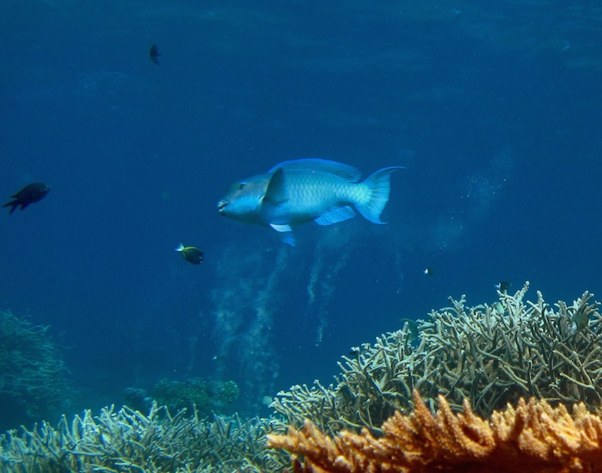
Generated Content
Parrot fish are a group of marine fish known for their beak-like jaws, which they use to scrape algae off coral and rocks. They play a crucial role in maintaining the health of coral reefs by controlling algae growth. Parrot fish are colorful and can be found in tropical and subtropical waters around the world. They undergo a unique process of changing colors and genders throughout their lives. Some species of parrot fish can grow quite large, reaching lengths of up to four feet. They are also known for their ability to produce sand by grinding up coral, which contributes to the formation of sandy beaches.

